Slide 1
MACHINE LEARNING, AI, AND DATA SCIENCE CONFERENCE
November 19-21, 2019

Slide 2
Deep Learning for NLP Applications
Arun Gururajan, Data Scientist, E + D
Farid Tajaddodianfar, Data Scientist, E + D
Zheng Dong, Data Scientist, E + D

Slide 3
Session goals
Provide a general overview of a traditional text classification pipeline in NLP
Provide a good understanding of word embeddings focusing on Word2Vec and FastText
Provide a clear overview of 1-D CNN’s for Text classification that builds upon the concept of embeddings – we will focus on approaches that leverage both pre-trained embeddings as well as learning a custom embedding layer
All of the above items will be taught in the context of a practical example – “IMDB movie review classification”, with three notebooks (focusing on each of the afore-mentioned areas)
We expect the lab to help the audience be comfortable to the point where they start to apply the techniques/code (in the lab) to their own NLP classification applications
Notes:
This slide is required. Do NOT delete. This should be the first slide after your Title Slide.
This slide should describe what your goals are for this session. This information lets your audience know what you are trying to accomplish with your talk or tutorial—ie, what value will attendees get by investing 25 minutes or 2 hours of their time listening to you.
You should not spend more than 1 minute presenting this slide.
General examples of session goals could be (you will have to create your own specific goals):
Introduce a new technique or approach to solve a customer problem
Compare two approaches and explain why one is superior
Describe a project and the learnings that audience members can apply from it
Teach audience members how to use a specific technology

Slide 4
Prerequisites
Anaconda 3 (Python 3.5+)
Keras (+ Tensorflow backend)
Gensim
NLTK
Github link to materials (git clone): https://github.com/FarTaFar/MLADS19_DL4NLP

Slide 5
Part1:
Basics

Slide 6
NLP and Text Categorization
Sentiment Analysis
Spam Detection
Document Tagging
Rank Results
User Categorization
….
Natural Language Understanding
Natural Language Processing
Natural Language Generation

Slide 7
Supervised Learning with NLP
Raw
Training
Dataset
Cleaning
Tokenization
Vectorization
Features
Labels
Classification
Model
Raw
Test Dataset
Featurized
Test Dataset
Eval
Metrics
Test
Labels

Slide 8
Data Cleaning
This is a problem-specific task.
Remove punctuation
Reduce inflected (or deviated) words
Stemming – cutting off the end of the words
E.g., Studies => Studi (stem); Studying => Study (stem)
Lemmatization – use a dictionary for morphological analysis of the words
E.g., Studies and Studying both convert to Study (lemma)
Stop-words Removal
Common words –the, is, at, which, on …
C. Manning, R. Prabhakar, and S. Hinrich. "Introduction to information retrieval." An Introduction To Information Retrieval 151.177 (2008): 5.
S. Bird, E. Klein, and E. Loper. Natural language processing with Python: analyzing text with the natural language toolkit. " O'Reilly Media, Inc.", 2009.

Slide 9
Tokenization
Words
Characters
N-grams – consecutive sequence of n items (words, characters, etc.)
Unigram
I
like
this
movie
I like this movie
Bigram
I like
like this
this movie
Trigram
I like this
like this movie
Text
Word-level n-grams
C. Manning, R. Prabhakar, and S. Hinrich. "Introduction to information retrieval." An Introduction To Information Retrieval 151.177 (2008): 5.
S. Bird, E. Klein, and E. Loper. Natural language processing with Python: analyzing text with the natural language toolkit. " O'Reilly Media, Inc.", 2009.

Slide 10
Vectorization
One-hot encoding – simple and based only on the existence of the term
Instance 0001
I
like
this
movie
Instance 0002
I
really
enjoy
this
movie
Instance 0003
I
like
this
movie
hate
miss
Vector | I | Like | Movie | Really | Enjoy
0001 | 1 | 1 | 1 | 1 | 1
0002 | 1 | 0 | 1 | 1 | 1
Hate | Miss
0 | 0
0 | 0
1 | 1
0003 | 1 | 1 | 1 | 0 | 0
Bag-of-Words: Same as One-hot except it includes term frequency
TF-IDF – combines Term Frequency and Inverse Document Frequency
C. Manning, R. Prabhakar, and S. Hinrich. "Introduction to information retrieval." An Introduction To Information Retrieval 151.177 (2008): 5.

Slide 11
Useful Libraries
NLTK - A suite of libraries and programs in Python
Lexical Analysis – Word and text tokenizer
N-gram and collocations
Tree model and Text chunker for capturing
Named-entity recognition
Beautiful Soup – A python package for parsing HTML and XML docs
Links
Tags

Slide 12
Practical example
IMDB Dataset
50K highly polarized reviews
Keras have a built-in function to load the dataset.
The dataset has been divided into evenly for training and testing.
Both training and testing have equal number of positive and negative reviews.
Today’s Lab
Training with 1hot-encoding and Bag-of-words features
Using Random Forests

Slide 13
Feature Selection
Today’s Lab
Up to the first 100 words per review
Top 10K words by overall frequency in the dataset
More Advanced Methods for Ranking
Chi-square
SNR
ROC

Slide 14
Part2:
Contextual Word Embedding

Slide 15
What’s the problem with BoW features?
Bag-of-Words (or TF/IDF) feature vectors are:
Long (length increases with the vocabulary size, e.g. 20,000~50,000
Sparse (most elements of the vector are zeros)
Improvement?
Learn one vector per word that is
Short (length 50 ~ 1000)
Dense (most elements are non-zero)

Slide 16
What is the benefit of short dense vectors?
Short vectors are easier to be used as features in machine learning (fewer parameters and smaller models)
Dense vectors are better in capturing semantic similarity
In practice, they work better!

Slide 17


Word Embedding Concepts
Start by randomly assigning an M-dimensional vector to each word
During training, move vectors closer if they appear in the same context
In vector space, we can use cosine to measure similarity between words
crash
poor
crash
car
excellent
good
car
excellent
weak
poor
good
exceptional
α
exceptional
α
$$\cos{α}=0.50$$
weak
$$\cos{α}=0.95$$
“More than a good movie; it’s in the category of exceptional ones.”

Slide 18
How to train Word2Vec?
Two main architectures:
Skip-gram
(pick a word and try to predict what is around it, aka its context)
Continuous Bag of Words
(pick context words and try predicting a target)
T. Mikolov et al. “Distributed Representations of Words and Phrases and Their Compositionality,” in Advances in neural information processing systems, NIPS, 2013, pp. 3111–3119

Slide 19
Skip-gram architecture for training W2V
More than a good movie; it’s in the category of exceptional ones.
Positive {target, context}
Negative {target, context}
A moving window of
Length 5 (ignoring stop words)
{exceptional, good}
{exceptional, movie}
{exceptional, category}
{exceptional, ones}
{exceptional, go}
{exceptional, crash}
{exceptional, country}
{exceptional, peace}
Move over the corpus and build positive and negative samples
Try adjusting word vectors to
Maximize the similarity of (target word, context word) pairs drawn from positive class
Minimize the similarity of those pairs drawn from negative class

Slide 20
How FastText compares to W2V?
W2V needs to have a word in its vocabulary in order to produce a vector for it
Fails in cases where a word is observed for the first time
FastText
is based on the same concept and methodology as W2V
Considers a bag of word n-grams, not just a single word, to build the word vectors
Even if a word has not been observed before, it’s n-gram have likely been.
The model will still be able to produce a vector for unseen words.
P. Bojanowski, E. Grave, A. Joulin, and T. Mikolov, “Enriching Word Vectors with Subword Information”, Transactions of the Association for Computational Linguistics, vol. 5, pp. 135–146, 2017

Slide 21
Lab scenario
Take IMDB dataset of Keras
Train a FastText model from scratch
Visualize and understand the model performance
Build a RF classifier
Build sentence embedding from word embedding
Use sentence embedding as features

Slide 22
Part3:
Convolutional Neural Networks for Text Classification

Slide 23
Understanding Convolutions
Convolution Operation
In layman terms - Mathematical operation that involves sliding a signal (convolution filter or mask) over the length of another signal (Input)
Key idea: look for local patterns in the input that resemble the mask – convolution output will be high for areas where there is a close match
1 | 1 | 1 | 0 | 0
0 | 1 | 1 | 1 | 0
0 | 0 | 1 | 1 | 1
0 | 0 | 1 | 1 | 0
0 | 1 | 1 | 0 | 0
1 | 0 | 1
0 | 1 | 0
1 | 0 | 1
Convolution mask
Input

Slide 24
Understanding Convolutions
Signal
10 | 50 | 60 | 10 | 20 | 40 | 30
Mask
1/3 | 1/3 | 1/3
Valid regions for convolution (based on mask length)
Invalid areas
?
10 | 50 | 60 | 10 | 20 | 40 | 30
?
Invalid areas
1/3 | 1/3 | 1/3
1/3 | 1/3 | 1/3
1/3 | 1/3 | 1/3
1/3 | 1/3 | 1/3
1/3 | 1/3 | 1/3
1/3 | 1/3 | 1/3
1/3 | 1/3 | 1/3
?
40
40
30
23
30
?

Slide 25
Understanding Convolutions
Option 1: If you want the output response to use the entire signal (and be of the same length), then pad the input signal with zeros (padding length depends on convolution filter size)
0
10 | 50 | 60 | 10 | 20 | 40 | 30
0
1/3 | 1/3 | 1/3
1/3 | 1/3 | 1/3
Feature Map/Response
20 | 40 | 40 | 30 | 23 | 40 | 23
Option 2: If you want the output response to only use the valid region of the input, then ignore invalid areas – keep in mind that output will be of different (smaller length)
10 | 50 | 60 | 10 | 20 | 40 | 30
If input signal length is “M” and filter size is “N”, then output size = M – N + 1
Feature Map/Response
40 | 40 | 30 | 23 | 40

Slide 26
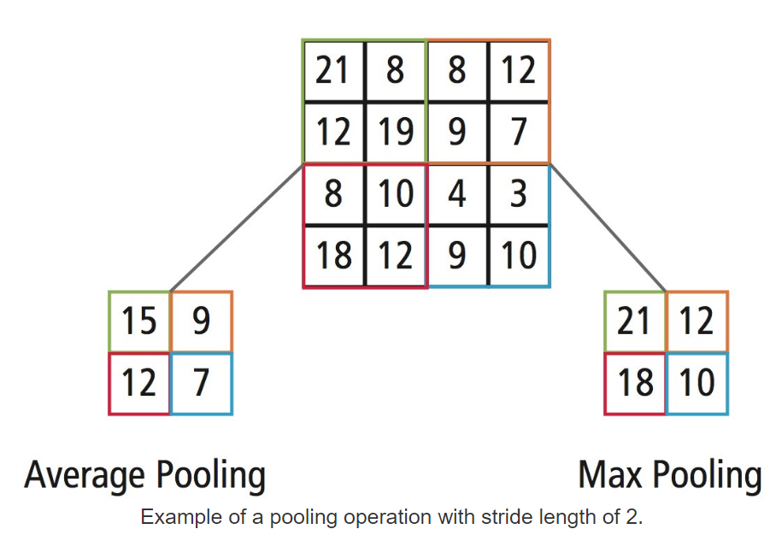
Pooling
Pooling (in the context of convolutions) is the process of downsampling – essentially getting a representative for a region or patch of a feature map (obtained via convolution)
40 | 40 | 30 | 23 | 40
40 | 30
(Max Pooling)

Slide 27
Text Embeddings
~300 columns (dimensionality of embedding)
X1 | X2 | X3
very
0.7 | 0.4 | 0.5
+
Sample FastText Embeddings
nice
0.2 | -0.1 | 0.1
+
picture
-0.5 | 0.4 | 0.1
=
very nice picture
0.4 | 0.7 | 0.7
Sum of FastText vectors can be a good text descriptor !

Slide 28
Better approach using 1D Convolutions
FastText Embeddings (say 300)
Very
Nice
Movie
0.7 | 0.4 | 0.5
0.2 | -0.1 | 0.1
-0.5 | 0.4 | 0.1
How do we make n-grams?
Very
Awesome
Picture
0.7 | 0.4 | 0.5
0.2 | -0.05 | 0.1
-0.4 | 0.35 | 0.1

Slide 29
Better approach using 1D Convolutions
FastText Embeddings (say 300)
Very
Nice
Movie
0.7 | 0.4 | 0.5
0.2 | -0.1 | 0.1
-0.5 | 0.4 | 0.1
0.9
0.6 | 0.4 | 0.5
0.2 | -0.1 | 0.2
Very
Awesome
Picture
0.7 | 0.4 | 0.5
0.2 | -0.05 | 0.1
-0.4 | 0.35 | 0.1
0.89
This (300 x 2) convolution filter provides high activations for two grams with a certain meaning
Can be extended to 3-grams, 4 grams etc. !

Slide 30
Better approach using 1D convolutions
I
like
this
movie
very
much
!
0.1 | 0.3 | -0.2 | 0.2 | 0.6
0.2
1 dimension of the convolution is fixed (= embedding layer dim)
Convolution happens along one dimension (time)
We get a 1-D vector of length (=input sample length)
Could we reduce the length of this vector ?
Yes ! Do Global Max Pooling
0.7
0.9
0.4
0.4
0.5
0.2
We can use multiple filters of lengths 3 that trigger for different combinations of words
Here we tried 3 groups of words using filter length of 3 – we can try multiple filter lengths !
Bottomline – try different filter lengths, and multiple filters within each filter length

Slide 31
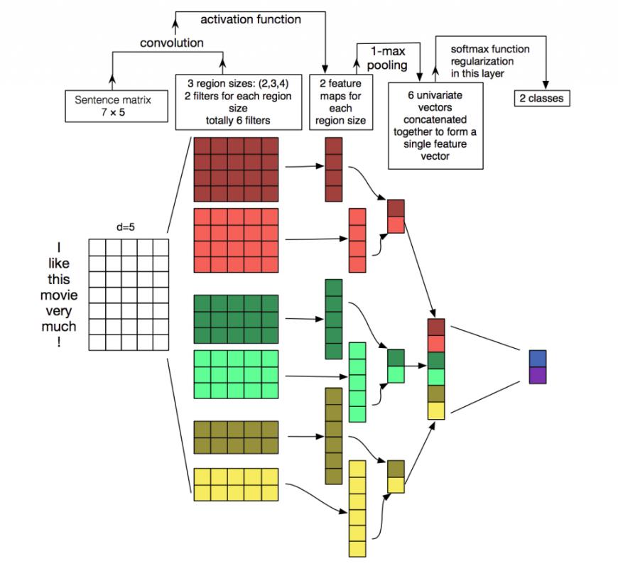
1-D CNN’s for Text Classification

Slide 32
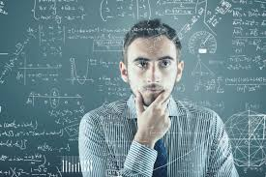
What next?
Are FastText/Word2Vec good enough?
Consider this example:
I filled up the bucket with a pail of water
I crossed this off my bucket list
My grandfather kicked the bucket
The context of the word “bucket” changes in every sentence
Static word embeddings fall short in capturing the essence of the sentence

Slide 33
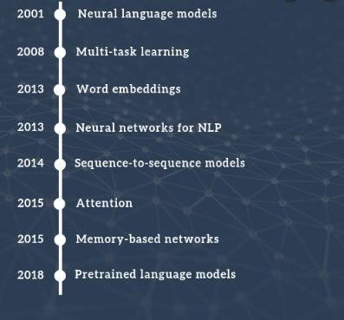

Next Steps
Further Reading
State-of-the-art Language Models (BERT, ELMO, GPT-2)
Interesting Neural Architectures for Text Classification (TextCNN, Bidirectional LSTM, Attention models)
Using Text Classification at your work:
NPS and other surveys – Sentiment analysis to understand promoters/detractors
Document classification & Tagging
Detecting malicious URL’s from page content
Contact us for questions:
Argurura (Arun Gururajan)
Dongzhe (Zheng Dong)
Fatajadd (Farid Tajaddodianfar)

